Slide 1


CS3003: Functional Programming

Slide 2
Applicative order vs Normal order
dbl x = (+) x x
average a b c = (/) ((+) a ((+) b c)) 3

Slide 3
Normal order
dbl (average 3 4 5)

Slide 4
Normal order
dbl (average 3 4 5)
+ (average 3 4 5) (average 3 4 5)
+ ((/) ((+) 3 ((+) 4 5)) 3) (average 3 4 5)
+ (4) (average 3 4 5)
+ (4) ((/) ((+) 3 ((+) 4 5)) 3)
+ (4) (4)
8

Slide 5
Applicative order
dbl (average 3 4 5)
dbl ((/) ((+) 3 ((+) 4 5)) 3)
dbl 4
+ 4 4
8

Slide 6
Implications of Applicative order

Slide 7
Thunk
a thunk is created for (average 3 4 5),
that thunk is passed to dbl, where it is duplicated during the reduction of dbl,
(average 3 4 5) is (eventually) calculated when the value of (average 3 4 5) is needed,
4 is stored (cached, memoized) in the thunk, and
the cached/memoized value is retrieved from the thunk instead of doing a fresh evaluation the next time that the value of (average 3 4 5)is needed.

Slide 8
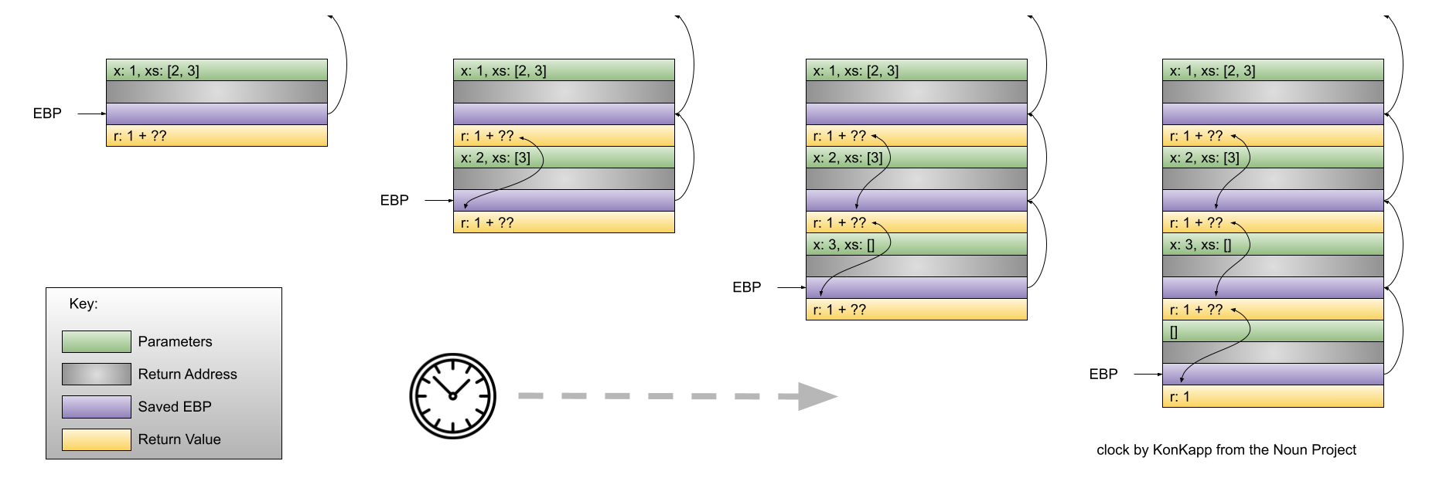
Recursion

Slide 9
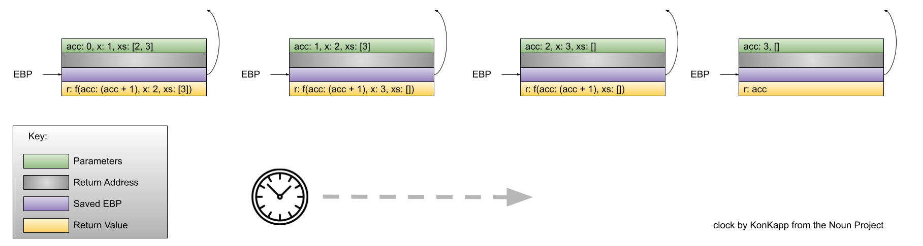
Tail Recursion

Slide 10
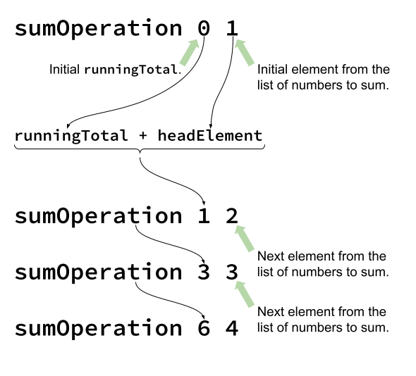
Whats going on?

Slide 11
Pattern found
A "driver" function that takes three parameters: an initial value (of a particular type, T), an operation function (see below) and a list of inputs, each of which is of type T.
An operation function that takes two parameters -- a running total, of some type R; an element to "accumulate" on to the running total (of type T) -- and returns a new running total of type R.
A list of inputs, each of which is of type T.

Slide 12
Types in Haskell
operation function: R -> T -> R
list of inputs: [T]
driver function: T -> (R -> T -> R) -> R -> R

Slide 13
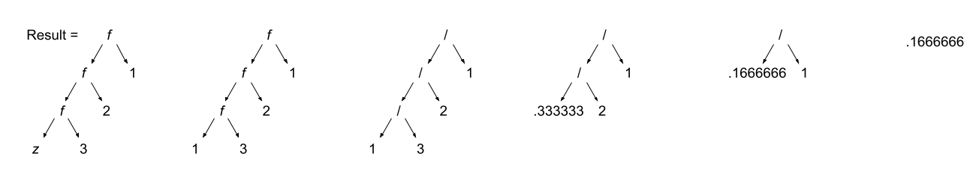
Fold left

Slide 14
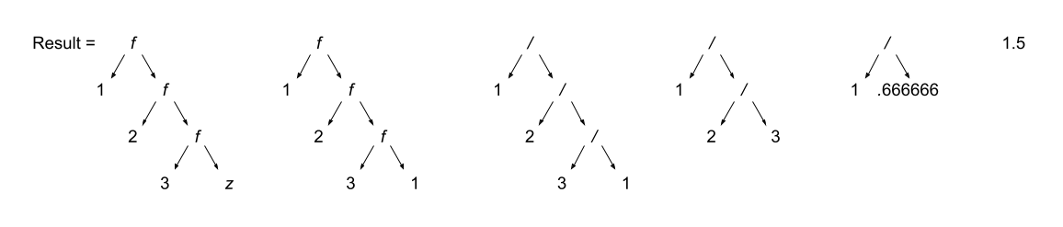
Fold right

